Slide 1

INTERNET OF THINGS

Slide 2
Disclaimer
This presentation is purely educational.
The views expressed by the presenter is not representation of any organization.
The views are based on professional experience of the presenter and no liability is accepted by the presenter in the event of any potential or perceived losses resulting from this presentation.
10 June 2020

Slide 3

Summer Internship Project Demonstration
Project Title : Remote Automation Control
Project ID :
Project Guide: Prof. Charanraj.B.S
Project Team : Rajath.J | PES1201801707
Ritvik kumar | PES1201801794
Chetan.S.R | PES1201801911
Date:

Slide 4
Project Abstract and Scope
In the present situation of the pandemic , it is daunting to see industry labourers and workers risk their lives and work on the site. Their safety is a big concern in the working environment.
However there are many new technologies which can work towards ensuring this security and IOT is one of them. Robotics has always been an important part of the industries , so our project aims towards combining the power of IOT and robotics to ensure safety in the industrial environment with minimal human interference - which is more popularly known as “Internet of Robot things”.
The IoRT always helps a robot function better since it gives the robot a more clear picture of the situation by the sensors or “smart objects” which are external to it.
We have built a working robot prototype and a sensor-machinery called “smart objects” which keeps on feeding the sensed data(in our case a temperature/infrared reading) to the robot.The robot also gives a feedback of its operation to the smart objects.
The robot is designed to operate in different modes based on the data received and act to ensure safety in case if the data received is depicting some danger. Node red ‘flows’ monitors the flow of sensory data from the smart objects to the actual bot.
The same basic idea can be extended to any number of robots by just taking care that each robot will have its own working email-id and by subscribing to a MQTT server . The idea can be used in any industry and even the safety of the data is ensured since the user has to provide his username , password to login to nodered ui and also we use email as a means of sending the data .
Date

Slide 5
Design Approach
A robot , a few smart objects and node-red flows are built. There can be any number of these basic structures but these three are must and important building blocks of the project.
Smart objects consists of temperature sensors, servo based door/lid objects and a infra-red sensor.
The temperature/infra-red readings and even the messages like ‘the door is open/closed’ is sent via Bluetooth to a node-red flow running on a computer/android phone in close proximity to the smart objects-end. The flow then transmits this information to another flow ‘main’ which is running on a computer in close proximity to the robots.
Both the flows have a UI interface associated with them, where the user can enter the email-id to channelise the data flow between the required smart objects and the required robot.
Date

Slide 6
Design approach contd….
The robot also has a flow called ‘main’ which should be running on a device close to it , so that it could receive messages and readings from the flow via Bluetooth. The robot is designed to operate in different modes like the line-follower mode, object-detection mode and the normal mode.This mode is dictated by the data received by the flow.
The robot sends a feedback about its operation from the flow “main” to the smart
objects.
The user can also manually control the robot from anywhere using a noed-red based UI called “manual control” on his phone or laptop.

Slide 7
Design Constraints and Assumptions
The basic approach of the design is by configuring Arduino with node-red . Node-red can be used as a tool for wiring together the hardware devices ,API's and online services .
In our case we use node-red to collect the data from the bot ,process the data to a suitable form so that the information sent can be used by the other bot to perform specific operation. It is assumed that every robot and the smart objects involved is provided with a unique email-id using which a separate communication channel is allocated to each of them.
A Dashboard is also been provided for the user interface to control the bot manually by selecting the mode of operation and can also be used to get sensor outputs ,notification regarding the condition of the bot. The user can access the dashboard by just logging in through the specified email-id. If the user interface is not on , then the bots act as dynamic swarm by performing operation depending on the data received by communicating between them.
Date

Slide 8
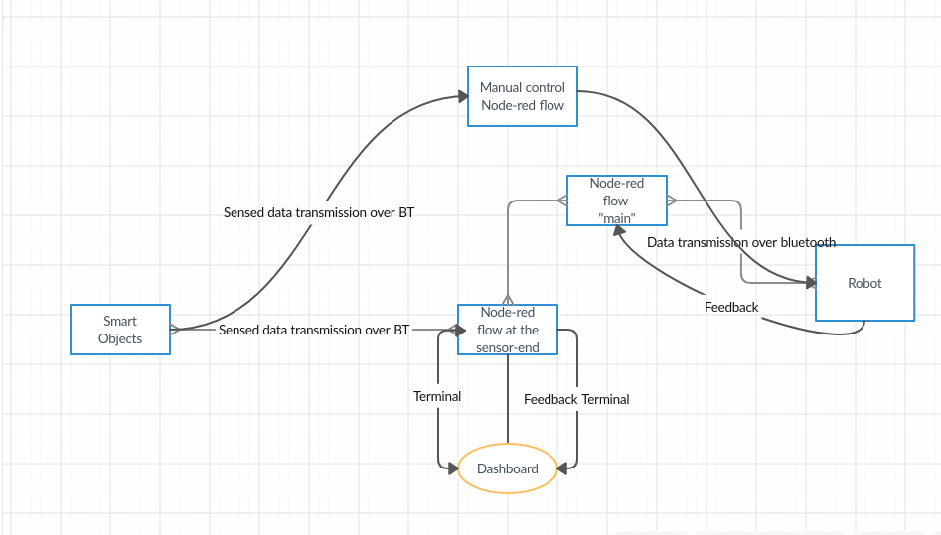
Project Flow

Slide 9
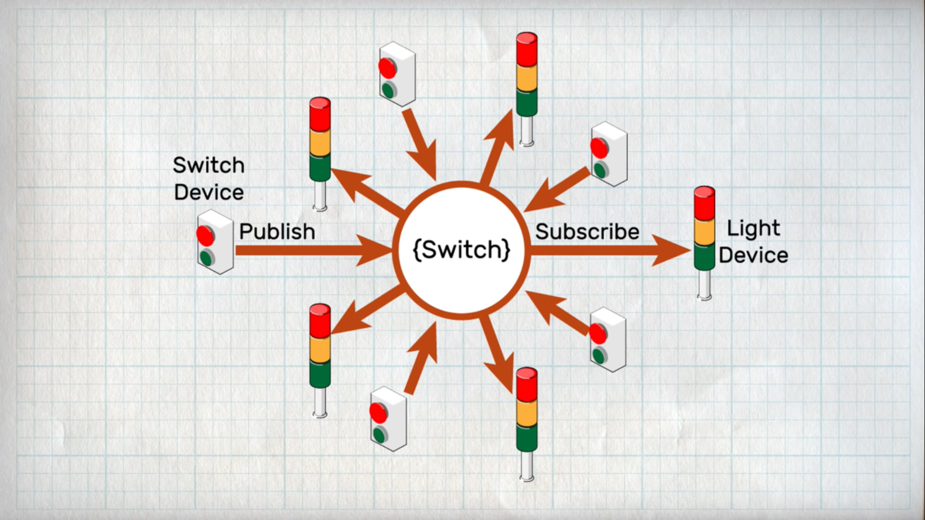
Communication can be established for n number of bots and sensors by just running a single flow but this time we need to define a MQTT server
where the sensors publish the data to the server, and the robots recieve the data by subscribing to the server.

Slide 10
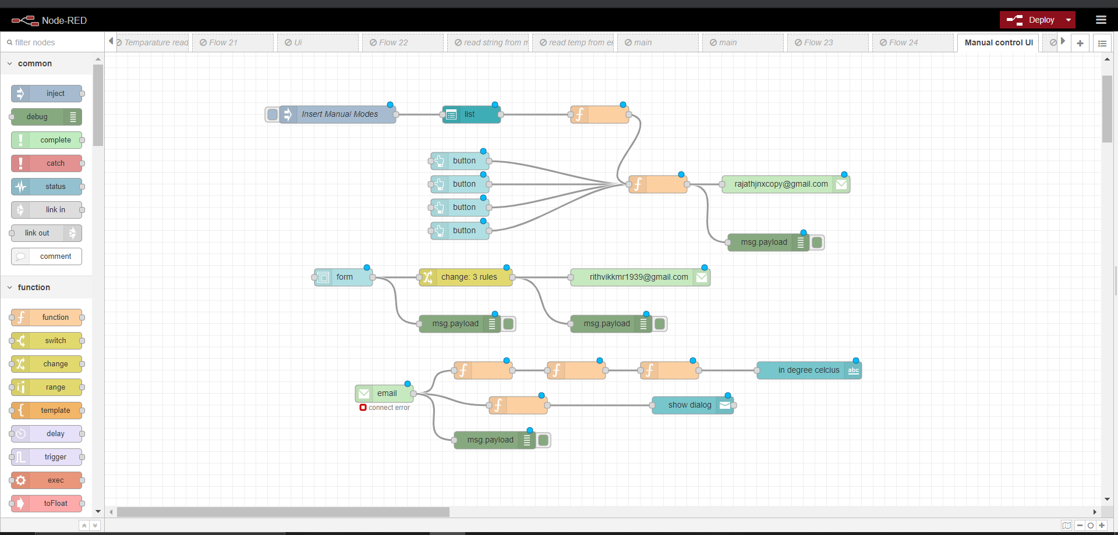
FLOWS
1) To Manually control the robot

Slide 11
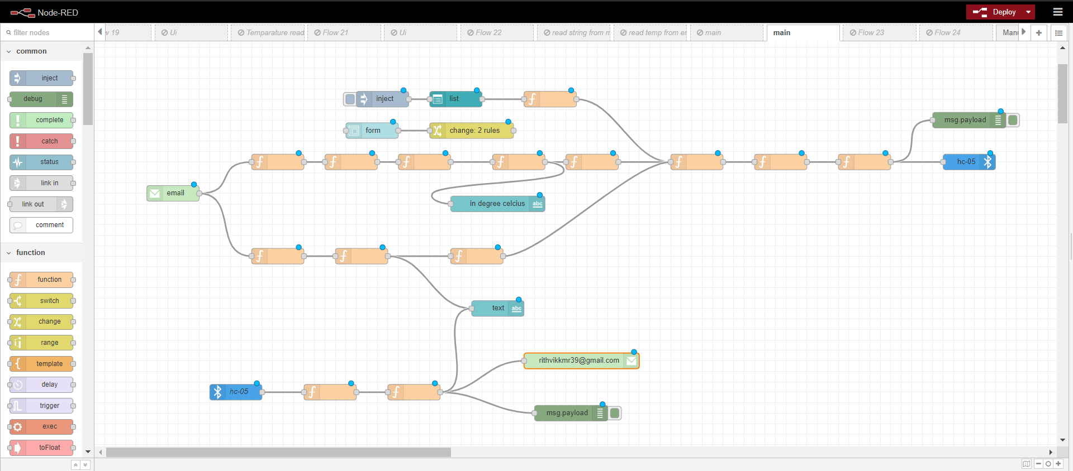
2)”main” - the flow running in proximity to the robot

Slide 12
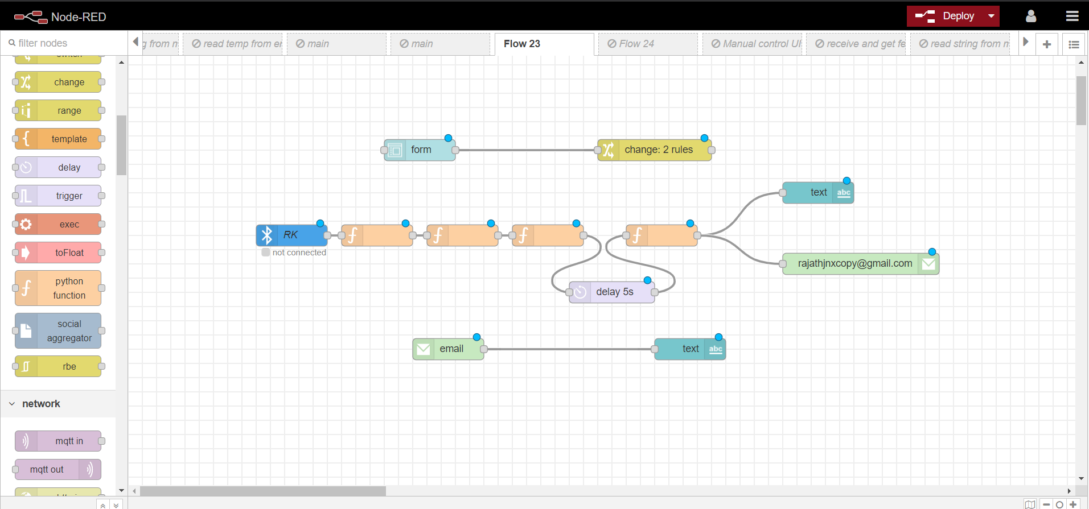
3)”sensor-end”-the flow running in proximity to the smart objects

Slide 13
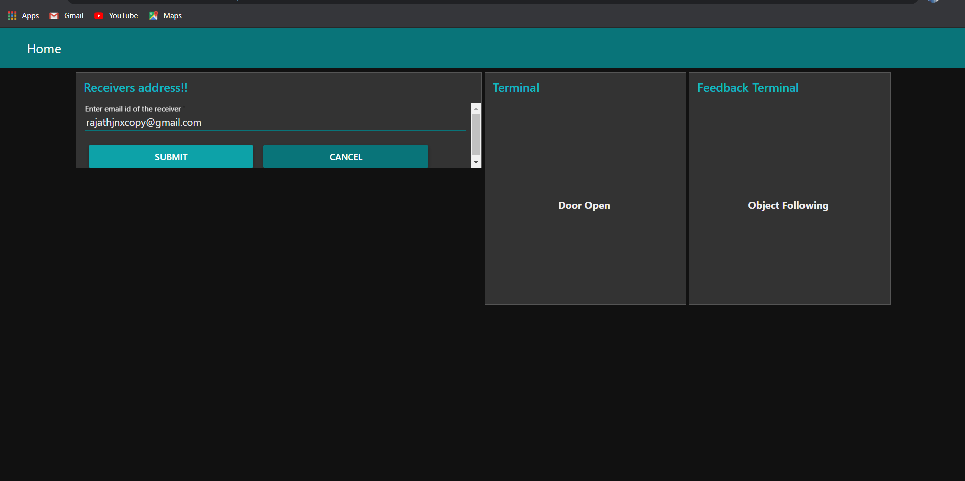
DASHBOARD

Slide 14
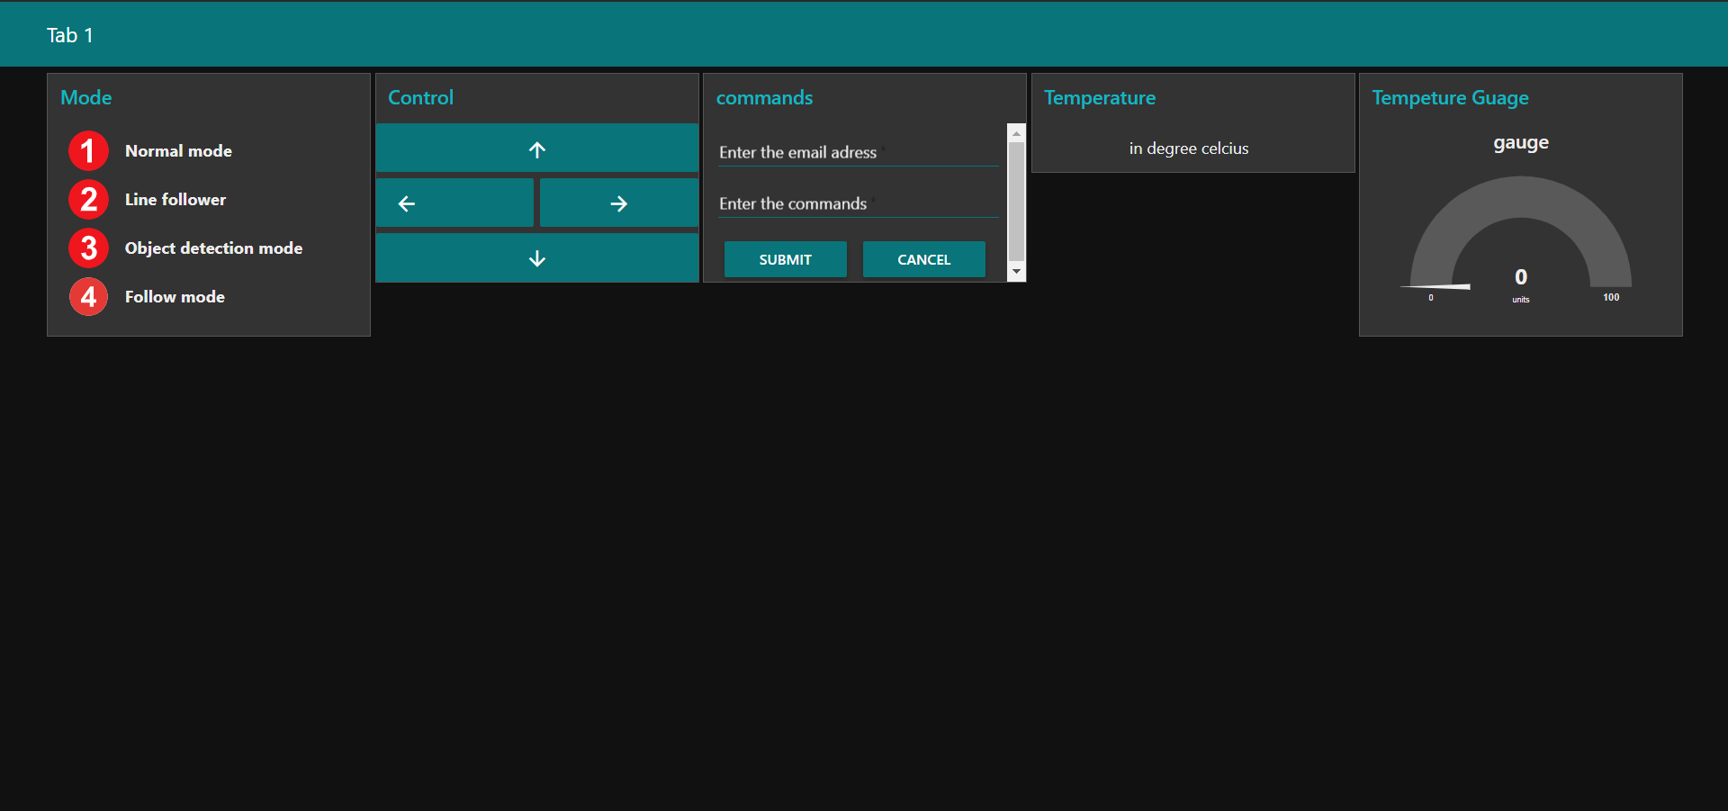

Slide 15
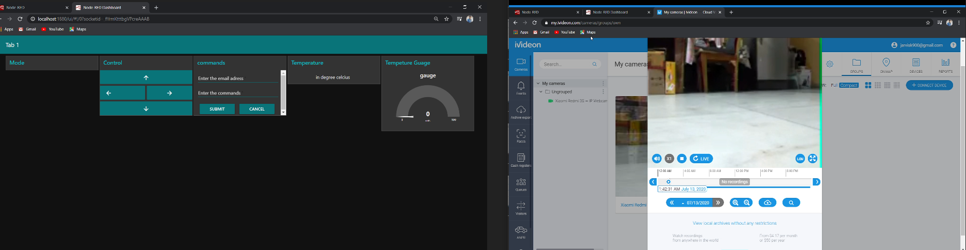
Manual control UI
Video Feedback from the bot

Slide 16
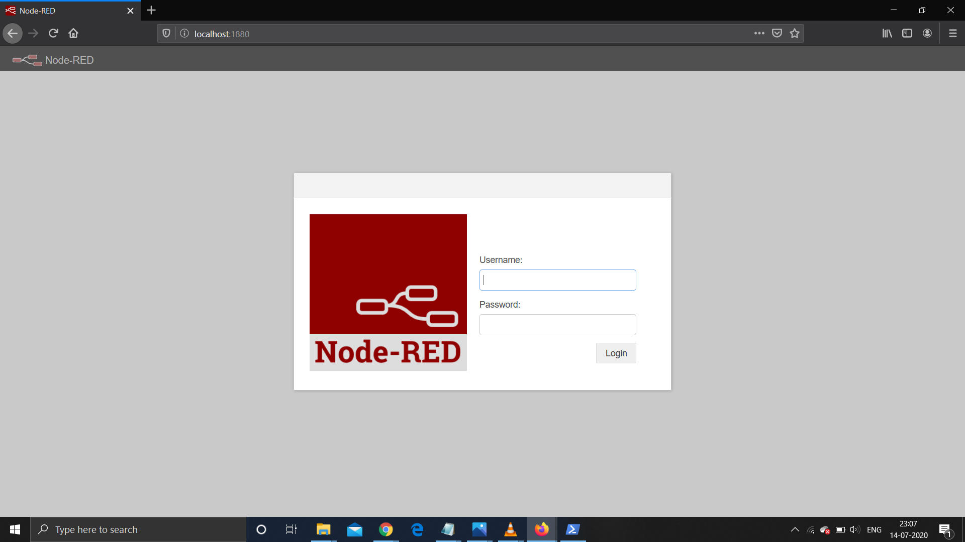

Slide 17
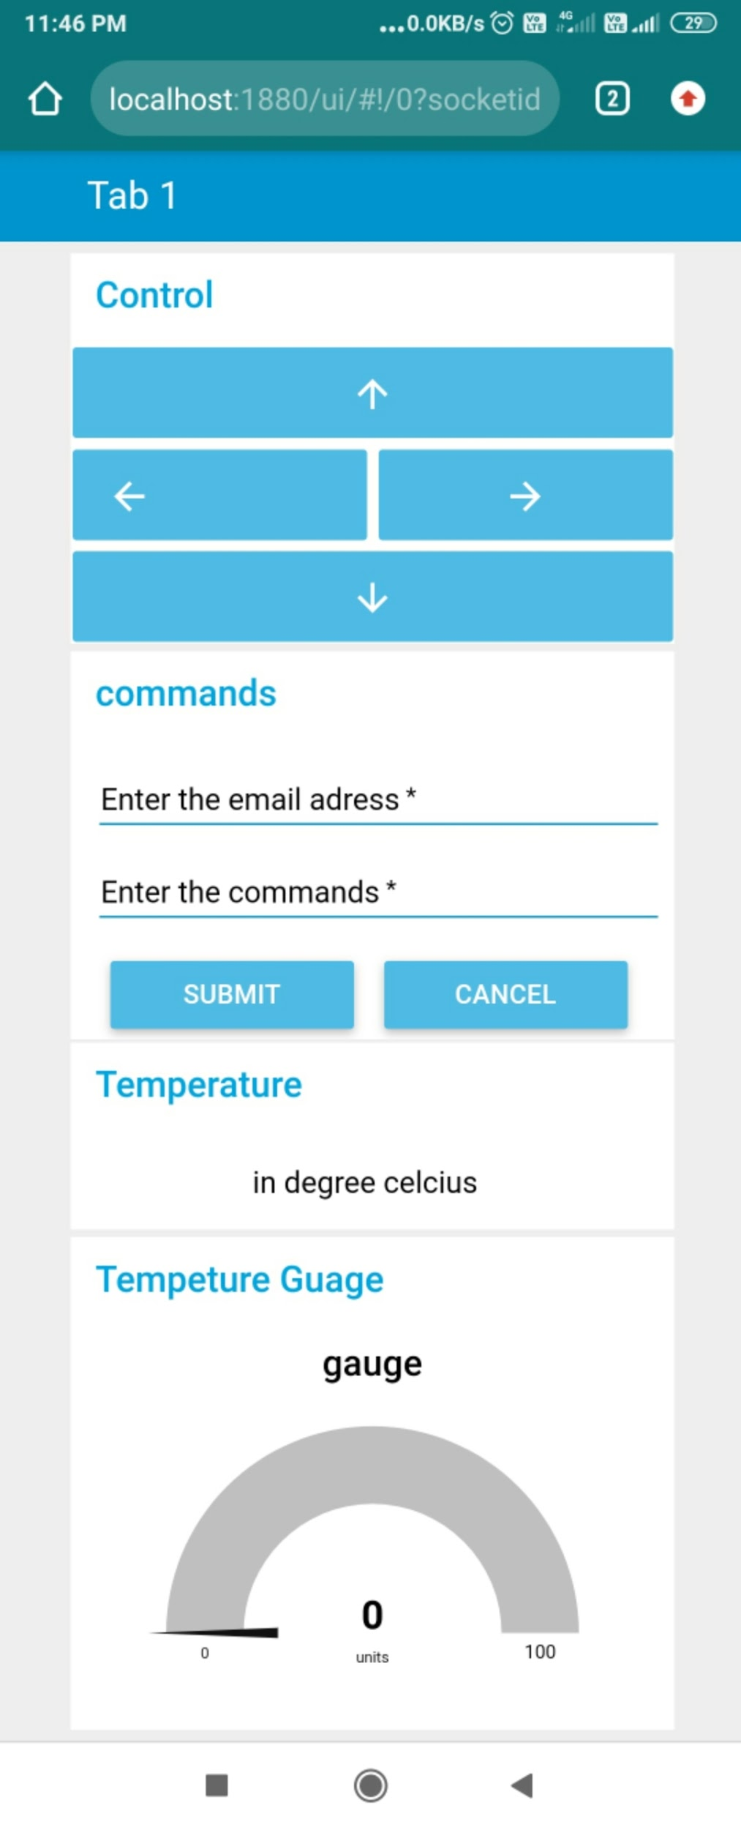
Mobile Interface for manual control over the bot

Slide 18
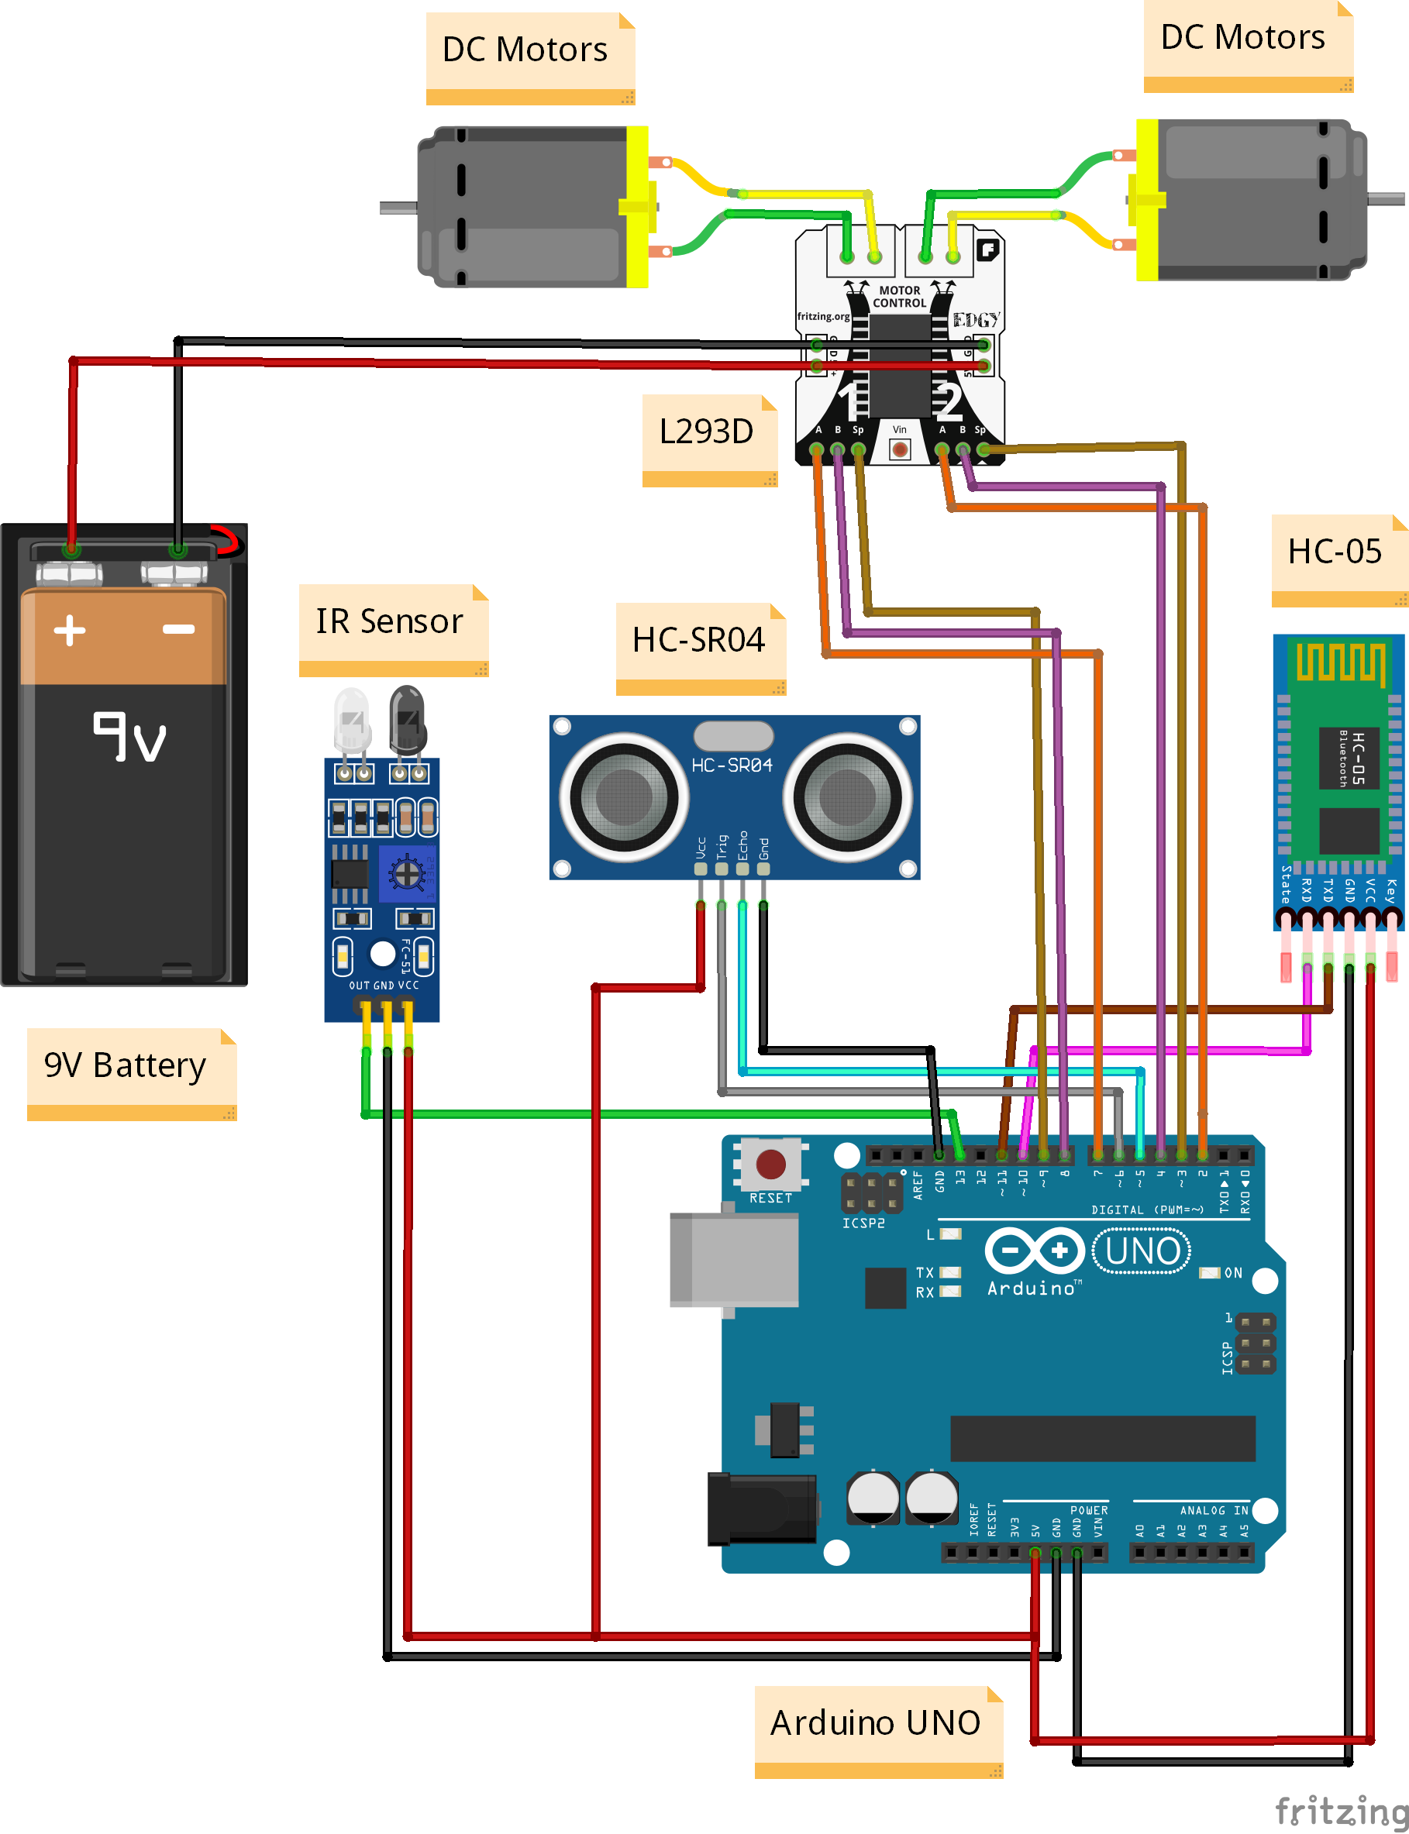
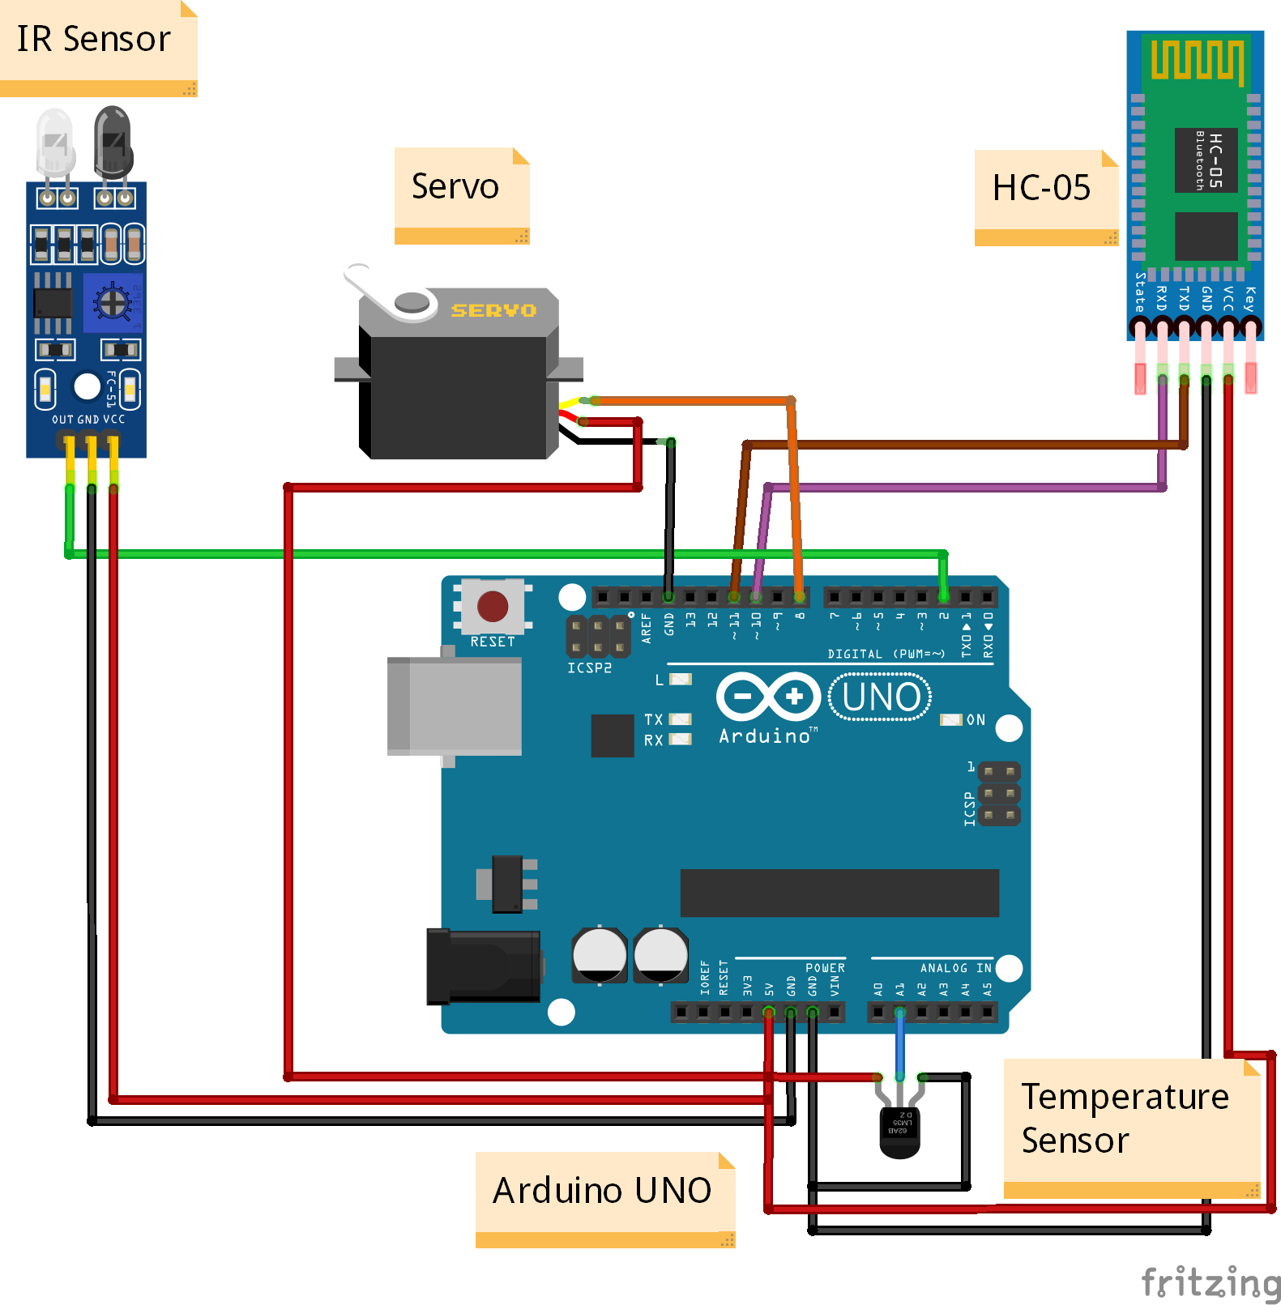
Circuit Diagram

Slide 19
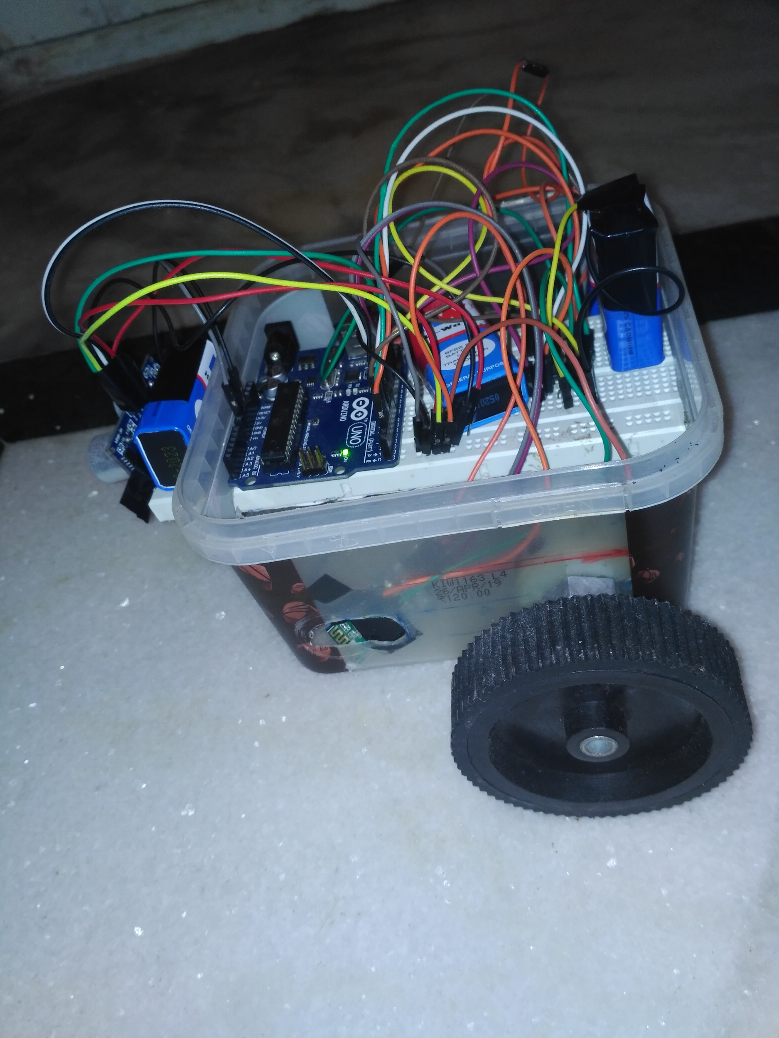
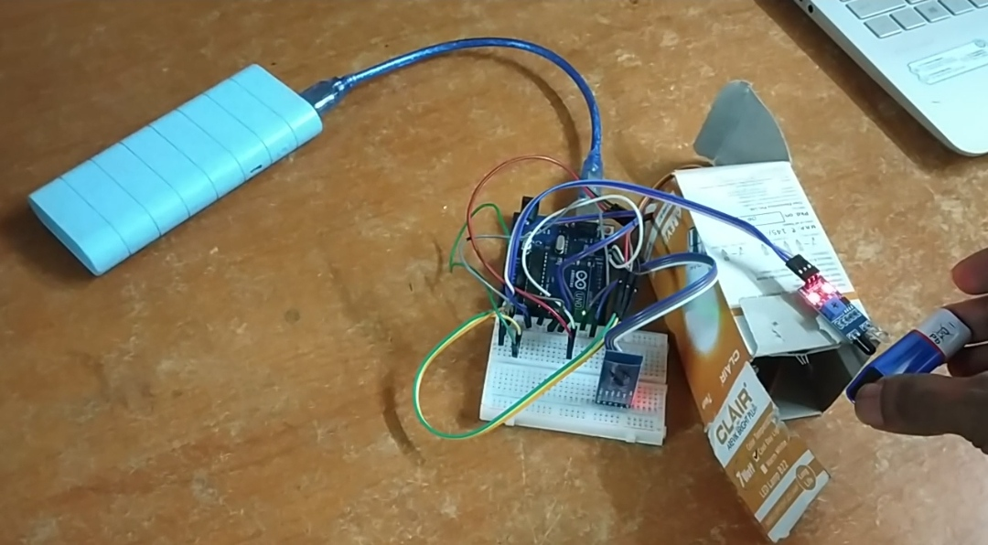

Slide 20
Technologies Used
Arduino microcontroller/Arduino ide
Node-red
Gmail services
Ivideon
Android node-red interface
Date

Slide 21
Project outcome
At the end of the project we were able to get two remote equipments i.e. the smart objects and the robot work together by exchanging data with the aid of node-red.
This in-fact could work for any distance as ‘mails’ were used to relay the data .So the distance between bots for communication doesnt matter.
The robot continuously kept receiving the temperature readings/other data from the smart objects and based on it, changed its mode. It remained in normal mode if the temperature range is at a safe range and went to line follower mode if it fell in the range of danger .This in a scenario of a real industry like a chemical industry, would mean the same normal robot functioning in a normal mode would also adapt itself for an emergency situation , like moving towards the chemical-container whose temperature falls in a risky range and solving the problem.
Date

Slide 22
The sensory-end continuously received a feedback from the robot regarding what it is doing. The same was also displayed on the Dashboard.
We were also able to control the robot manually using a UI. A video feedback relayed by the robot helped the operator in controlling it.
The project was made scalable to further include any number of bots , by defining a MQTT server where the sensory node has to publish to the server at the same time n number of bots can subscribe to the server , to get information of the action it needs to perform.
The flows could in-fact run on any system android/computer .

Slide 23
Thank you
Date

